Slide 1
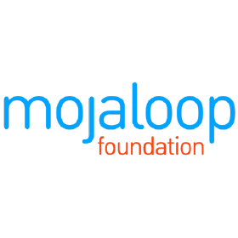
Go-to-Market Strategy for Open-Source Software with a Social Mission
Steve Haley (Mojaloop Foundation), Kyeyoung Shin (Oxford)
November 12, 2024

Slide 2

Oxford-Mojaloop Collaboration
In collaboration with the Mojaloop Foundation, Oxford University’s Future of Finance and Technology Initiative has been conducting research on the Foundation’s ecosystem.
Our research focuses on how to build and orchestrate an innovation ecosystem to tackle societal challenges.
Research outputs will be available soon!

Slide 3
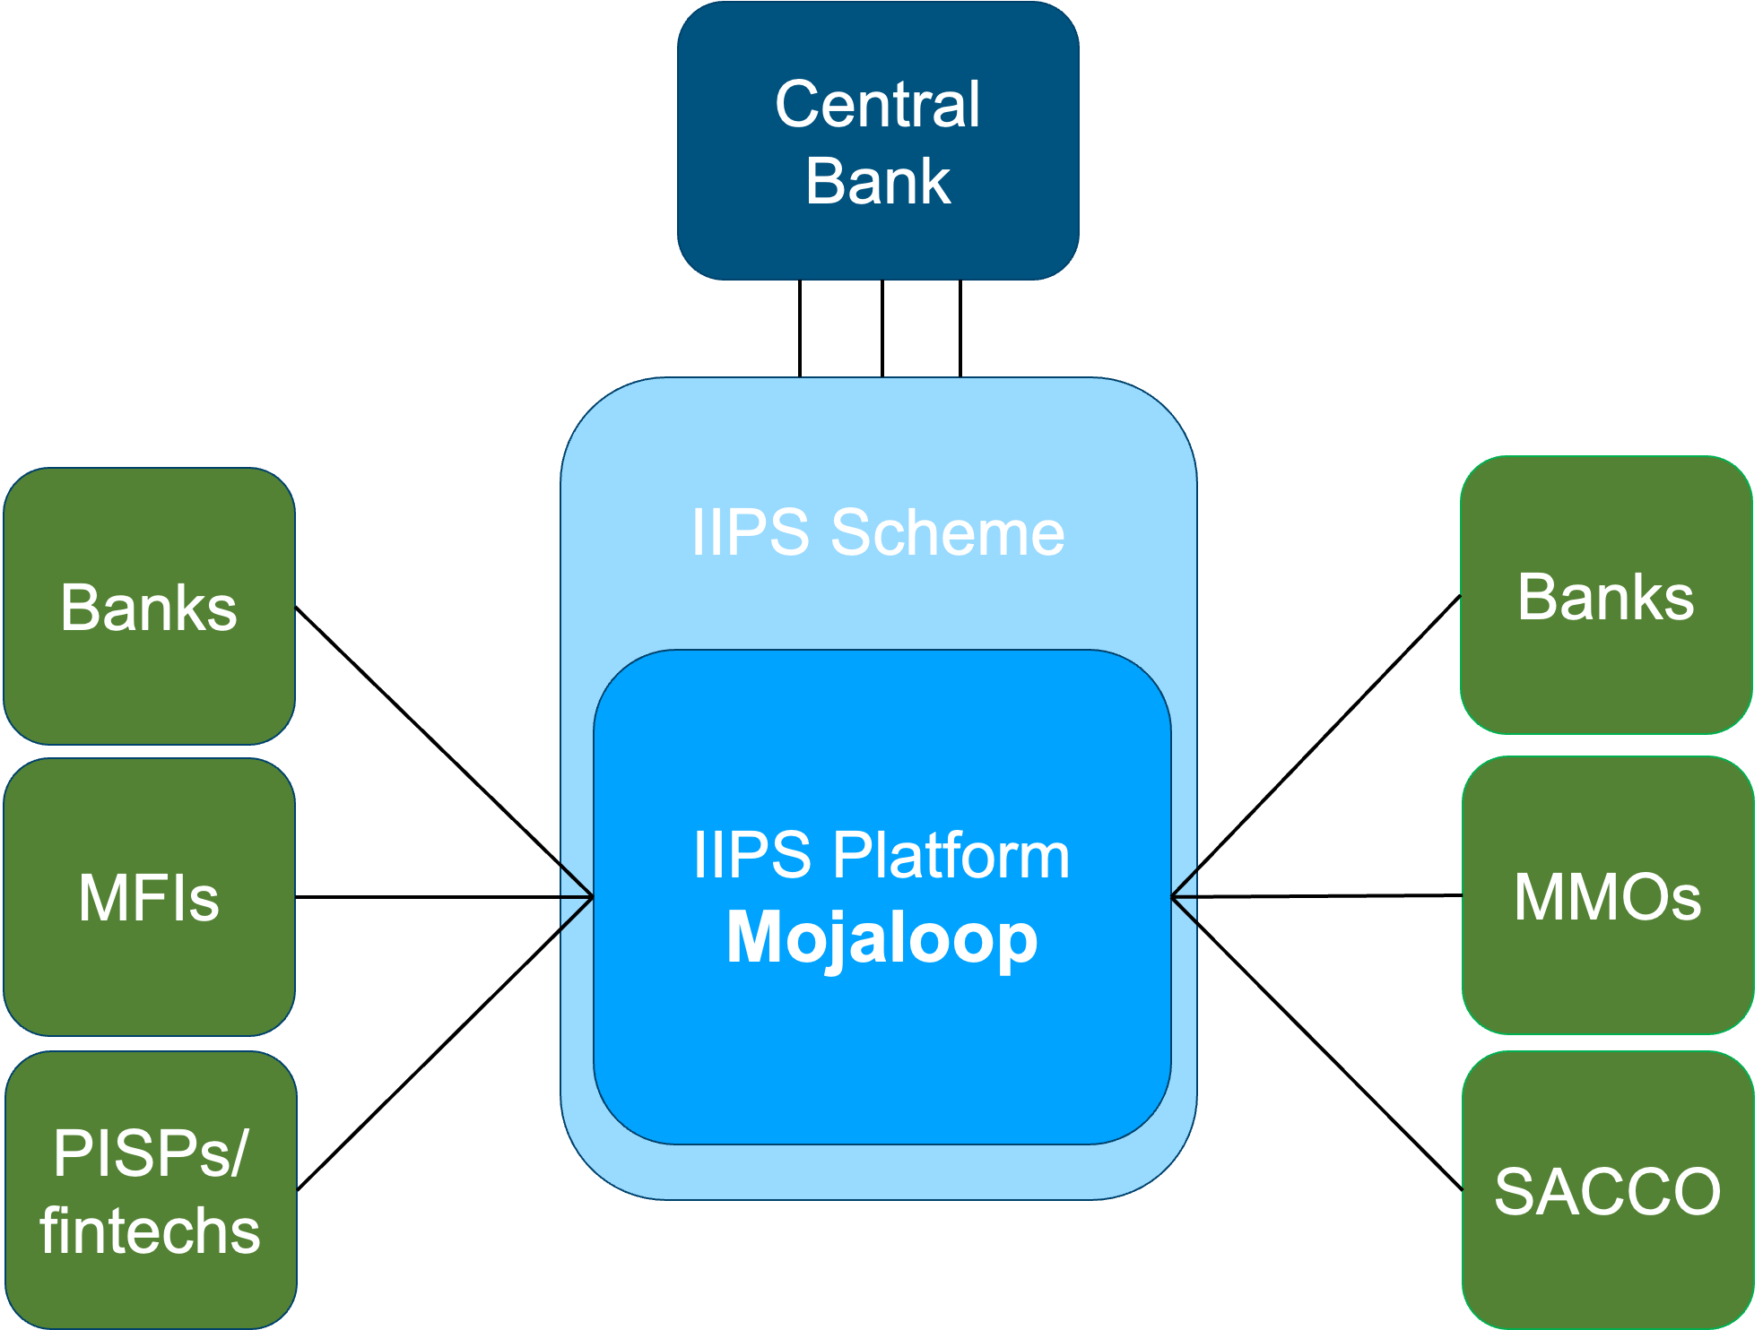
Mojaloop as a digital public good
DPGs contribute to tackling grand societal challenges, such as financial exclusion, by empowering communities with innovative, local solutions
Mojaloop aims to serve as an open-source payment platform that fosters interoperability, connecting banks, mobile money services, and financial institutions.
Building an inclusive innovation ecosystem is crucial.

Slide 4
Challenges in building an OSS ecosystem for financial inclusion
Lack of understanding of open-source software and resulting aversion
Entrenched procurement processes of governments and international financial institutions
Complexity of market timing for inclusive instant payment systems
Long sales cycle of national infrastructure projects and associated uncertainty

Slide 5
MF’s GTM strategy
GTM
Demonstrating value through action: Proof-of-Concept Program, Accelerator Program
Assisting adopters as an advisor: Strategic support, focus on inclusivity
Adapting messaging to market evolution: Sovereignty and inclusivity, shifting market dynamics
Ongoing challenges
Long sales cycle and uncertainty
Complex stakeholder coordination
Building and sustaining ecosystem trust
Resource management

Slide 6
Expansion and adoption: From 4 to 18 projects globally within one year, with active engagements in 23 countries. PoC success: Most PoC countries chose to implement Mojaloop; Accelerator Program graduates have won bids. Broader ecosystem growth: Stakeholder community expanded to 1,300+ participants across 81 countries. Key outcomes: Enhanced financial inclusion, national sovereignty
Impact

Slide 7
Lessons for other DPGs
Understand stakeholder concerns
Adapt to market dynamics
Foster collaboration
Embrace continuous iteration
Diversify to mitigate risks

Slide 8
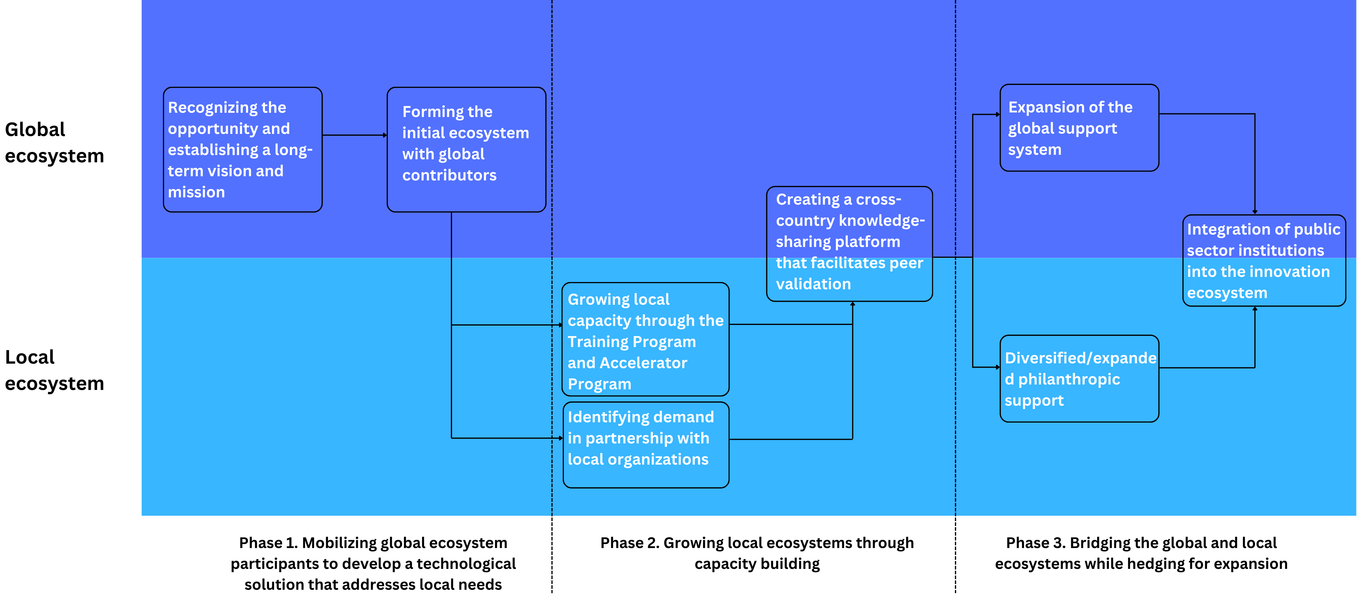
Lessons for other DPGs – A process model

Slide 9
Thank You
Kyeyoung Shin
(kyeyoung.shin.dphil@said.oxford.edu)
Steve Haley
(shaley@mojaloop.io)

